Slide 1

Getting started,
What do you need.

Slide 2




Downloads
https://www.oracle.com/java/technologies/downloads/
https://code.visualstudio.com/download
https://git-scm.com/downloads

Slide 3

FTC Downloads
https://developer.android.com/studio?gclid=Cj0KCQjwwvilBhCFARIsADvYi7IKKrYiB2wh6z25FHtIxR6tV7XfPQVhB5R2LQfVhNZgijsvSHvdPi4aAogEEALw_wcB&gclsrc=aw.ds

Slide 4
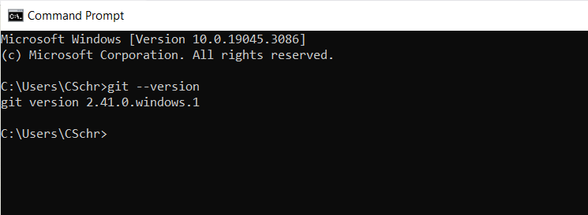
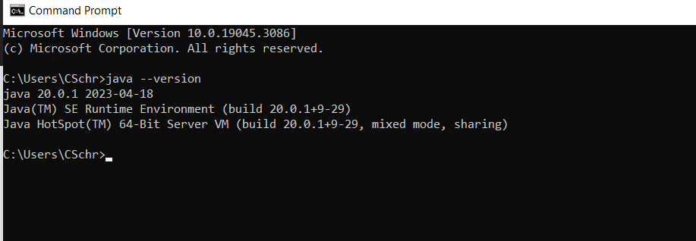
Making sure it’s all good.
Check everything is working by testing it in the terminal
Ex:
~ java --version
~ git –-version

Slide 5
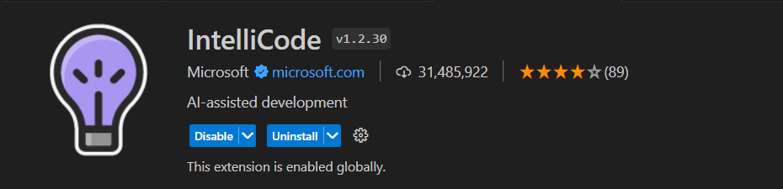
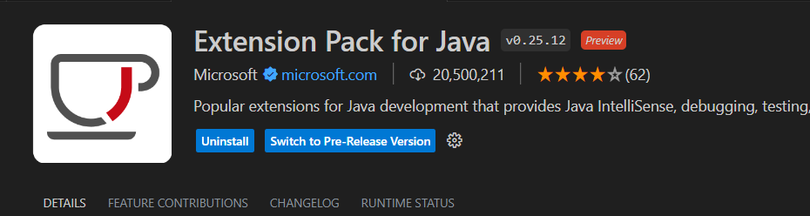
VSCode extensions

Slide 6
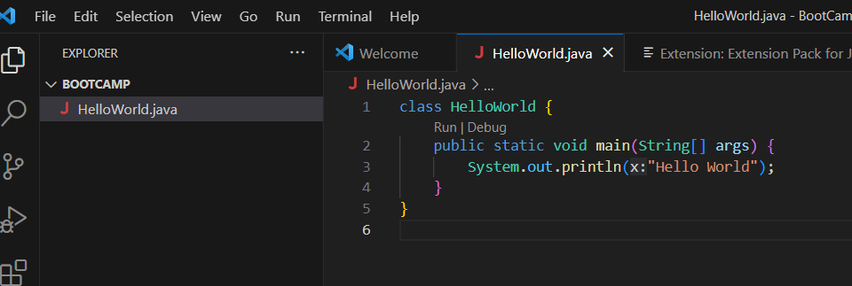
Hello World

